Slide 1
Project Title: PHONEPE TRANSACTION INSIGHTS Domain: Finance / Payment Systems Submitted by: Varshini S Batch Number: MTD47 [DS-S-WE-T-B30] Organization Name: GUVI COURSE NAME: DATA SCIENCE

Slide 2
TABLE OF CONTENTS
SECTION | PAGE NUMBER
Introduction | 3
Problem Statement | 4
Tools And Technologies Used | 5
Approach and Workflow | 6
Database Design | 7
SQL_ Business Case Study | 8
Python And Streamlit Dashboard | 13
Power BI Visualization | 15
Business Recommendations | 16
Conclusion | 17

Slide 3
INTRODUCTION
With the growing adoption of digital payment platforms like PhonePe, analyzing transaction data has become crucial for driving informed business decisions. This project explores PhonePe's transaction trends across India to uncover patterns in user engagement, insurance penetration, and digital payment preferences.
The aim is to transform raw JSON data from PhonePe into actionable insights through SQL analysis, Python-based processing, and interactive visualizations using Streamlit and Power BI. These insights are used to support business decision-making in areas such as marketing, product development, and regional expansion.

Slide 4
PROBLEM STATEMENT
Objectives: To Understand and analyze PhonePe transaction data to gain insights into user behaviour, market performance, and insurance penetration.
Challenges Addressed:
Growing digital payment usage
Need for better user targeting
Understanding geographical transaction dynamics
Improving product strategies and insurance performance

Slide 5
TOOLS AND TECHNOLOGIES USED
S.NO. | Tool/Technology | Purpose
1 | GitHub | Source of PhonePe JSON data
2 | Python | Data processing, transformation, analysis
3 | Pandas, Matplotlib, Seaborn | Data analysis and visualizations
4 | MySQL | Structured storage and querying of transformed data
5 | Streamlit | Web-based interactive dashboard
6 | Power BI | Business-oriented dashboard and advanced visualizations
7 | SQLAlchemy + PyMySQL | Connection between Python and MySQL database

Slide 6
APPROACH AND WORKFLOW
Step 1: Data Extraction from GitHub
Step 2: SQL Database Setup (MySQL)
Step 3: Table Creation – Aggregated, Map, and Top tables
Step 4: Data Analysis using SQL Queries
Step 5: Visualization using Python (Matplotlib, Seaborn), Streamlit, and Power BI
Step 6: Insight Generation and Recommendations

Slide 7
DATABASE DESIGN
Overview of key tables:
Aggregated-
agg_user,
agg_trans,
agg_insur
Map-
map_user,
map_trans,
map_insur
Top-
top_user,
top_trans,
top_insur

Slide 8
SQL-Based Business Case Studies
Case Study 1: Decoding Transaction Dynamics on PhonePe
State-Wise Transaction Growth- Identifies which states are growing, stagnant, or declining in transaction volume and helps PhonePe focus on declining states to improve adoption and marketing strategies.
Transaction Category Trends- Analyzes UPI, Wallet, and other payment modes to see which ones are gaining or losing traction and guides feature improvements based on user preferences.
Regional Variations- Highlights state-wise variations in transactions, allowing PhonePe to adjust regional business strategies and for example, if UPI transactions are declining in Tamil Nadu, PhonePe can run targeted promotions.
Quarterly Performance Tracking- Helps the leadership team compare performance across quarters and spot seasonal trends and for example, higher transactions in Q4 might indicate festive season spikes.
Market Strategy Optimization- Growing areas → Invest more in rewards, cashback, and partnerships.
Table areas → Maintain engagement but focus on customer retention.
Declining areas → Identify issues (e.g., competition, user drop-off) and improve incentives.

Slide 9
Case Study 2: Device Dominance and User Engagement Analysis
Identify Top Engaged Brands
Brands with high engagement rates (higher app opens per registered user)
Can help optimize app experience for popular brands
Detect Underutilized Devices
Devices with high registrations but low app opens
These may require UX improvements, marketing efforts, or troubleshooting
Regional Device Preferences
Some brands may be more popular in certain states
Helps in targeted promotions and regional optimization
Growth Trends Over Time
Brands gaining traction vs. brands declining in usage
Can guide future business strategies

Slide 10
Case Study 3: Insurance Penetration and Growth Potential Analysis
Growth hotspots:
Identifies states with the highest insurance adoption growth.
Helps allocate marketing resources to rapidly growing regions.
Untapped markets:
Highlights states with low insurance penetration despite high transaction volume.
Prioritizes new regions for expansion.
Declining areas:
Reveals states where insurance adoption is stagnating or declining.
Suggests re-evaluating strategies in underperforming regions.
Category performance:
Shows which insurance types are most successful in each state.
Helps focus on profitable policy types.

Slide 11
Case Study 4: Transaction Analysis for Market Expansion
Identify High-Growth States
The avg_growth_rate column helps spot states with rapid transaction growth, which are ideal for further investment and marketing efforts.
Detect Market Saturation or Decline
States with low or negative growth rates may need intervention, such as better incentives, partnerships, or promotional offers.
Prioritize Expansion Based on Transaction Volume
High transaction amounts with low growth indicate mature markets, while high growth with low transaction amounts suggests emerging markets with potential.
Regional Insights for Strategic Decisions
The state-wise breakdown allows PhonePe to customize strategies based on transaction behavior in different regions.

Slide 12
Case Study 5: Transaction Analysis Across States and Districts
Top-Performing States & Districts
The states and districts with the highest transaction count and value will appear at the top.
This helps in prioritizing high-activity regions for business expansion or marketing.
Regional Market Trends
Comparing state vs. district transactions highlights localized market trends.
Some states might have high transactions overall, but specific districts could be underperforming or outperforming.
Targeted Marketing & Expansion Opportunities
Underperforming regions with lower transaction values can be analyzed for growth potential.
High-performing areas might indicate strong user engagement and opportunities for new service offerings.
Investment & Resource Allocation
Helps PhonePe decide where to invest in promotions, partnerships, and infrastructure.
If some districts have low transaction count but high value, they might be niche markets with high-value users.

Slide 13
PYTHON AND STREAMLIT DASHBOARD
Overview of Streamlit Usage
Streamlit was used as the primary framework to build an interactive web dashboard for visualizing PhonePe transaction data.
Python was used to write backend logic, process SQL query outputs, and connect visual components.
Interactive Filters:
Users can filter data by Transaction Type, State, Year, and Quarter.
Dropdowns dynamically update visualizations in real time, improving user control and data exploration.
Visualization Integration:
Used libraries like Plotly and Matplotlib within Streamlit to render bar charts, line graphs, pie charts, and maps.
Charts auto-update based on filter selections, enabling deep-dives into specific insights like top states, categories, and user engagement.
Page Navigation:
Implemented multi-page support using streamlit-option-menu to separate Home, Business Case Studies, and Dashboard sections.

Slide 14
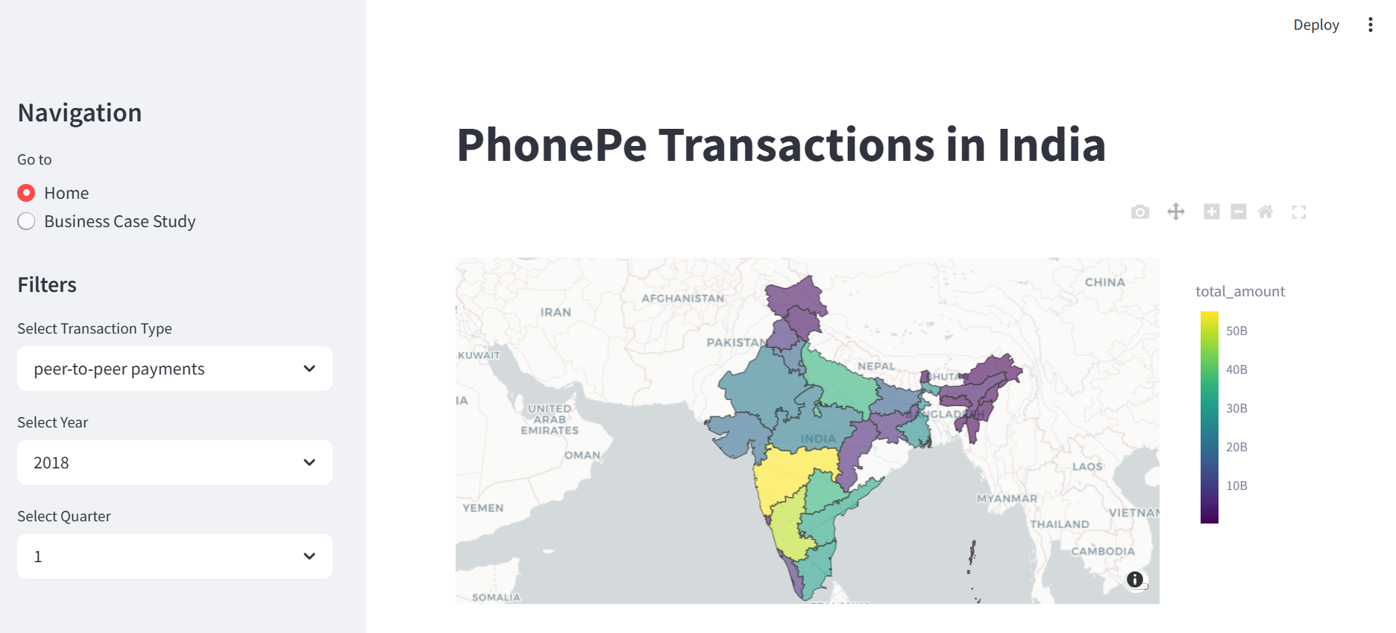
Real-Time Interaction Features
Live SQL Integration:
Used pymysql with SQL Alchemy to fetch data from a MySQL database.
Each filter selection triggers fresh data queries, ensuring insights are always up to date.
User-Friendly Interface:
The layout uses columns and tabs to organize content cleanly.
Visuals are responsive and load quickly with minimal code, providing a smooth user experience.
Screenshots of streamlit:

Slide 15
POWER BI VISUALIZATIONS
Overview of Power BI Dashboards
Power BI was used to create interactive dashboards for each of the five business case studies. These dashboards enabled intuitive exploration of the data, uncovering patterns and trends across regions, time periods, and transaction types. The dashboards were designed for ease of interpretation by non-technical stakeholders as well.
Types of Visualizations Used
Line/Bar Charts: Used to show year-wise and quarter-wise transaction growth and comparison.
Clustered Bar Charts: To compare multiple metrics like transaction count and amount across states or user categories.
Scatter Plots: To analyze the correlation between registered users and app openings or penetration metrics.
KPI visualizations : Used to measure and display progress toward a specific business goal or target.
Ribbon chart : It’s ideal for visualizing rank changes over time among multiple categories.
Pie charts : Used to show proportions or percentage shares of a whole.
Tree maps : Provides a hierarchical view of data using nested rectangles.

Slide 16
BUSINESS RECOMMENDATIONS
Targeted Campaigns for High-Performing States
Focus marketing efforts in top-performing states to further strengthen user engagement and adoption.
Market Expansion in Low-Penetration Districts
Utilize district-level insights to identify regions with low transaction volumes but high potential.
Optimize Payment Categories Based on Usage
Invest more in promoting frequently used transaction categories and improve the user experience around them.
Enhance Insurance Product Offerings
Based on insurance penetration analysis, roll out more region-specific insurance products.
Improve Retention Strategies
Use user engagement data to identify churn risk zones and develop loyalty/rewards programs accordingly.

Slide 17
CONCLUSION
The PhonePe Transaction Insights project successfully demonstrated the end-to-end data analytics pipeline – from data extraction and transformation to visualization and insight generation.
By analyzing key transaction metrics, state/district-level trends, and insurance penetration, the project provides a comprehensive understanding of digital payment behavior across India.
The integration of SQL, Python, Streamlit, and Power BI ensured both analytical depth and interactive presentation of insights, useful for both technical and business audiences.

